Slide 1
Support Vector Machines
Presented by:
Easwari Arumuga Perumal
Maniraaj Senthil Nathan
Sooriya Mathy
Instructor: Dr.Yasser Alginahi
Date:10/20/2023

Slide 2
Introduction
What is Support Vector Machines?
Support Vector Machine (SVM) is a relatively simple Supervised Machine Learning Algorithm used for classification and/or regression. It has a high accuracy in many applications, and it uses a concept of hyperplane that best separates the data[1].
Used across various domains, from image recognition to finance and medical diagnosis.

Slide 3
Types of SVM
SVM
Linearly Separable
Non-Linearly Separable

Slide 4
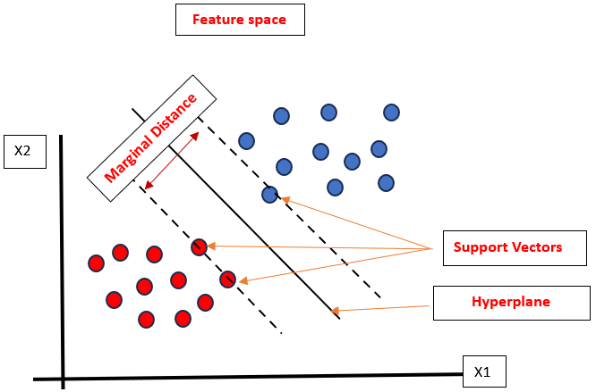
SVM Working
The main objective of SVM algorithm is to find a hyperplane in an n-dimensional feature space that separates the data with the largest marginal distance possible. The attributes of the hyperplane depend on the Support Vectors.
Scatter Plot Showing Support Vector Machine Working

Slide 5
Implementation
Find a hyperplane in an n-dimensional feature space.
Maximize the margin between the hyperplane and data points.
The attributes of the hyperplane depend on the Support Vectors.
Achieve optimal data separation for accurate classification and regression.
Scatter Plot Showing State Vector Machine Working

Slide 6
Terminologies
Hyperplane: The n- dimensional plane that separates the data . The dimension of the hyperplane depends on the number of features (n).
Support Vectors: Support vectors are the data points that are close to the decision boundary, they are the data points most difficult to classify, they hold the key for SVM to be optimal decision surface[2].
Marginal distance: It is the perpendicular distance from the optimal hyperplane to the nearest support vectors. It is essentially the distance between the hyperplane and the support vectors[2].

Slide 7
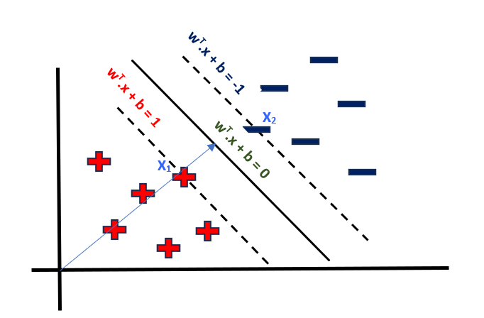
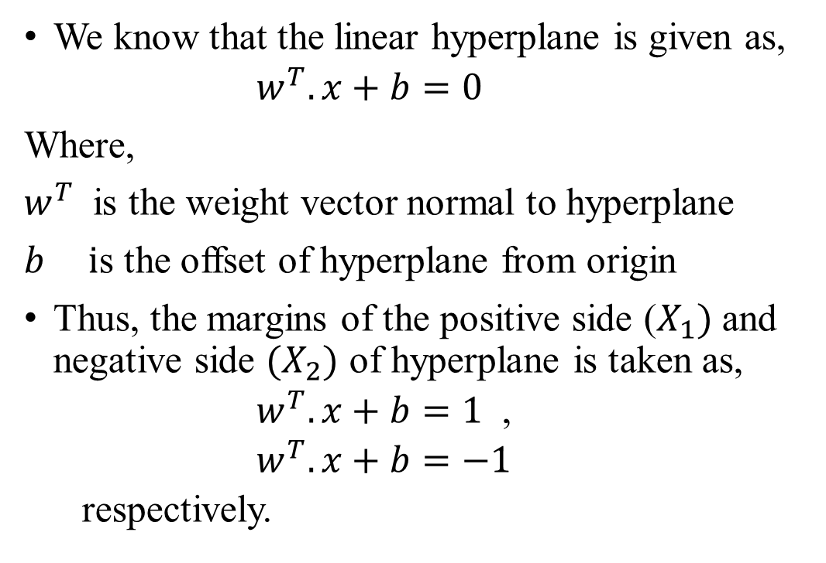

Mathematical Intuition of SVM
We know that the linear hyperplane is given as,
$w^{T}.x+b=0$
Where,
$w^{T}$ is the weight vector normal to hyperplane
$b i$s the offset of hyperplane from origin
Thus, the margins of the positive side ($X_{1})$and negative side ${(X}_{2})$ of hyperplane is taken as,
$w^{T}.x+b=1$ ,
$w^{T}.x+b=−1$
respectively.
$$w^{T}$$
Margin and Hyperplane equation

Slide 8
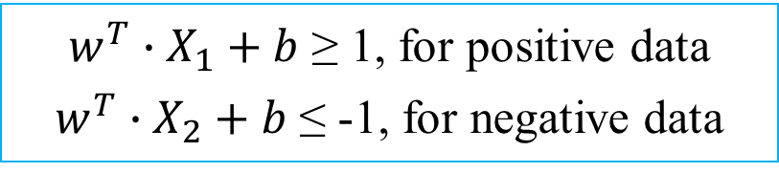
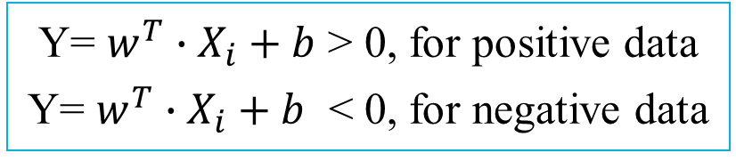
Mathematical Intuition of SVM
Firstly, to classify a data point as negative or positive, we define a decision rule such that, if
Now it is also significant to consider the constraint that, there should be no data points lying in between the hyperplane and the margins. Thus,
Y= $w^{T}∙X_{i}+b$ > 0, for positive data
Y= $w^{T}∙X_{i}+b$ < 0, for negative data
$w^{T}∙X_{1}+b$ ≥ 1, for positive data
$w^{T}∙X_{2}+b$ ≤ -1, for negative data

Slide 9
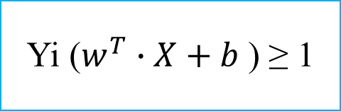
Mathematical Intuition of SVM
Thus, considering the positive classes have y = +1 and y = -1 for negative class the decision condition can be optimized as
Yi ($w^{T}∙X+b$ ) ≥ 1

Slide 10
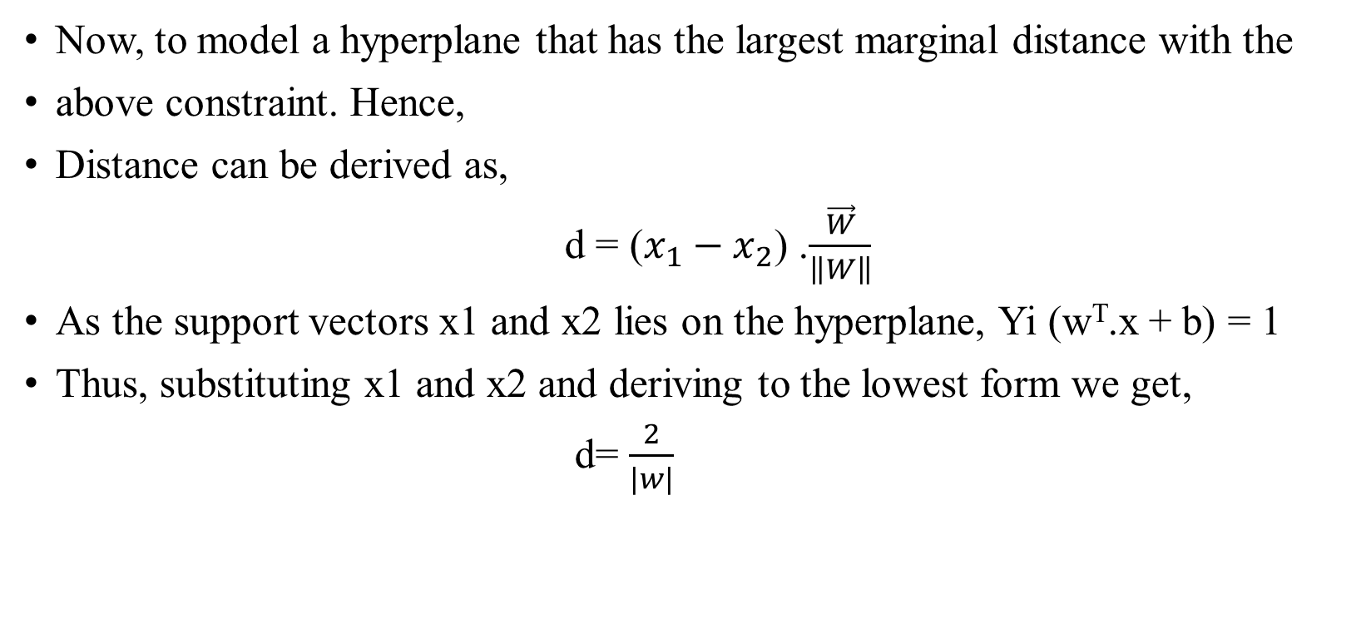
Mathematical Intuition of SVM
Now, to model a hyperplane that has the largest marginal distance with the
above constraint. Hence,
Distance can be derived as,
d = ($x_{1}−x_{2}$) .$\frac{\vec{W}}{\left\|W\right\|}$
As the support vectors x1 and x2 lies on the hyperplane, Yi (w^{T}.x + b) = 1
Thus, substituting x1 and x2 and deriving to the lowest form we get,
d= $\frac{2}{|w|}$

Slide 11
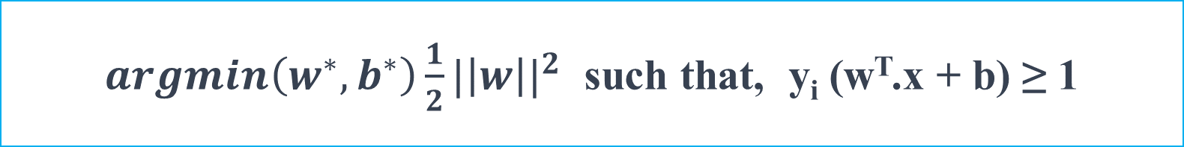
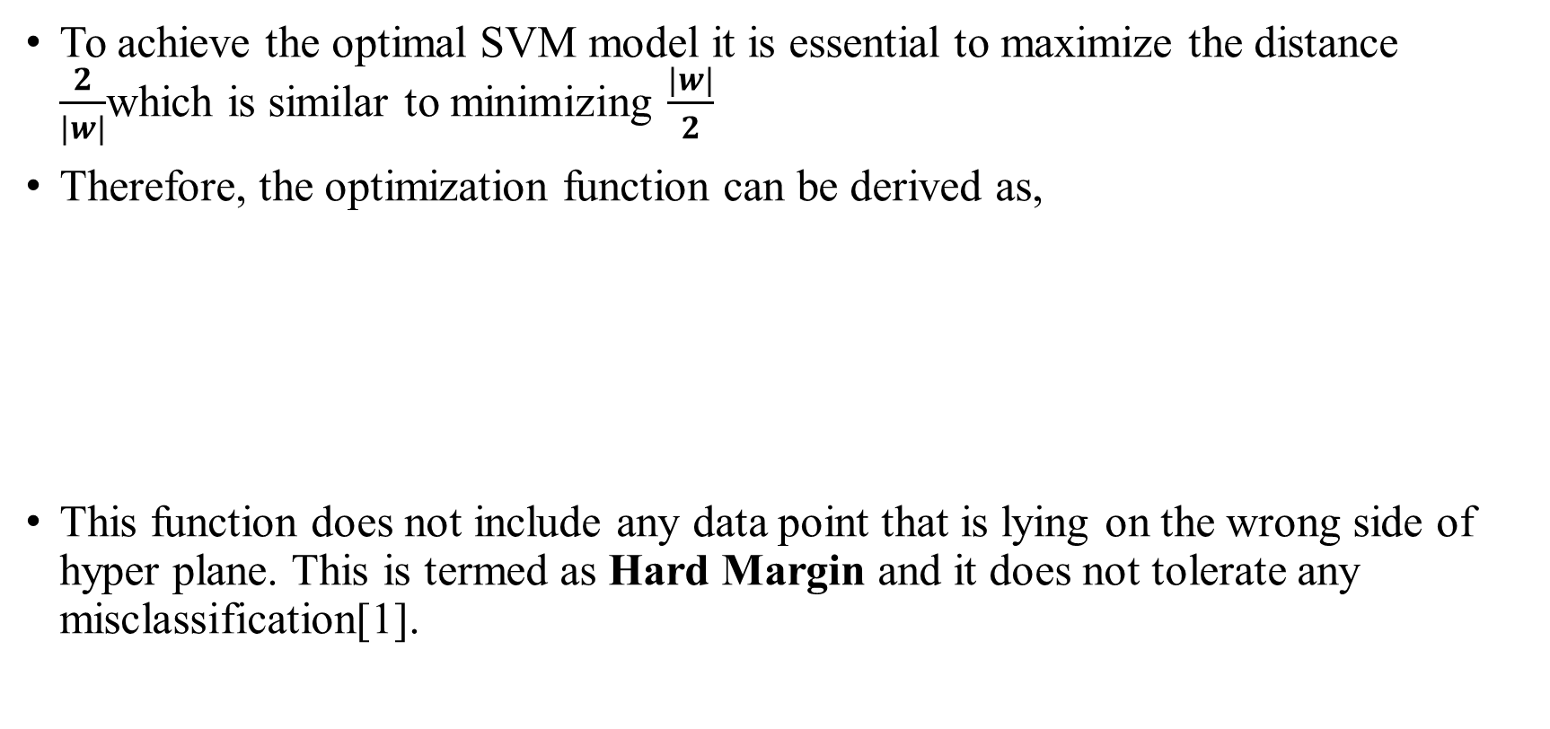
Mathematical Intuition of SVM
To achieve the optimal SVM model it is essential to maximize the distance $\frac{2}{|w|}$which is similar to minimizing $\frac{|w|}{2}$
Therefore, the optimization function can be derived as,
This function does not include any data point that is lying on the wrong side of hyper plane. This is termed as Hard Margin and it does not tolerate any misclassification[1].
$argmin\left(w^{∗},b^{∗}\right)\frac{1}{2}{|\left|w\right||}^{2}$ such that, y_{i} (w^{T}.x + b) ≥ 1

Slide 12
Dual Problem
But just minimizing the w gives only a constraint optimization problem as there would be outliers in real world data.
The "dual problem" is a mathematical formulation used to find the Lagrangian multipliers that are essential for solving the primal problem of maximizing the margin while minimizing classification errors[3].
Lagrangian multipliers are used in functions to account for constraint conditions while it simultaneously maximizes or minimizes the objective function.

Slide 13
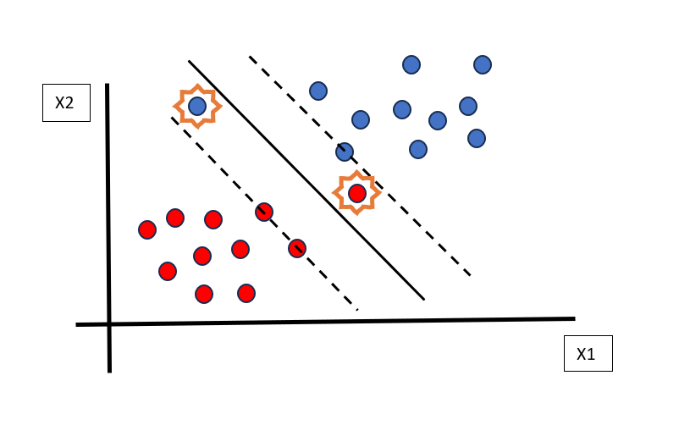
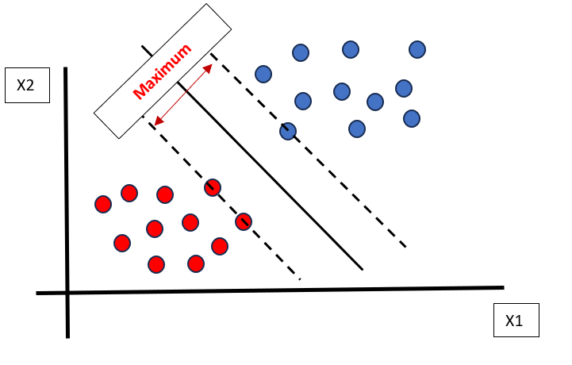
Dual Problem
The two constraints in the dual problem of SVM are,
Outliers that lies on wrong side of hyperplane should be optimized.
Maximizing the marginal distance by minimizing the |w|.
This can be achieved my introducing a Lagrangian multiplier ζ that maximizes the dual objective function and a cost function C.
Thus, we arrive at SVM with Soft Margin that allows some degree of misclassification.
Misclassified data points constraint
Maximizing margin constraint

Slide 14

Optimization Function
Thus, we derive at the optimization function of SVM for Soft Margin,
Where, C is the cost function hyperparameter that can be tuned
ζ represents the distance of misclassified point from their respective margins
i is the datapoint lying on wrong side of hyperplane.
$$argmin\left(w^{∗},b^{∗}\right)\frac{1}{2}|\left|w\right||+C\sum_{i=1}^{n}{ζ_{i}}$$

Slide 15
Optimization Function
The Cost function C controls the trade-off between maximizing the margin and minimizing the classification error.
the value of C is determined by trial and error process and choosing the Value of C that best fits the model using the validation metrics.
This type of SVM is called C-SVM and to resolve this discrepancy Hyperparameter tuning, we use a alternative formulation of SVM called nu-SVM.
Nu-SVM introduces the “nu” parameter , which is a user defined value and has a range from 0 to 1. The value of nu depends on the fraction of training errors and support vectors.
Thus, this is the final optimized model for linear SVM.

Slide 16
Why we need Non-Linear SVM:
Datasets that are linearly separable with some noise work out great:
But what are we going to do if the dataset is complex?
0
x
Figure showing linear data in 1-Dimension
0
x
Figure showing non-linear data in 1-Dimension

Slide 17
Why we need Non-Linear SVM:
Let’s map the given data to high-dimensional Space:
x²
0
x
Figure showing Non-Linear Data in 2-Dimension

Slide 18
Non-Linear SVM and Kernel Function
From the previous slide we can witness that if the data points are remapped into high-dimensional space, the non-linear data becomes easily separable. This is done using a Kernel function in SVM.
The Kernel Function is a critical component employed to transform data from its original feature space into a higher-dimensional space.
A kernel function, denoted as K(x, y), takes two data points, x and y, as input and computes the dot product of these points in the higher-dimensional space without explicitly mapping them to that space. Mathematically, this can be represented as:
K(x, y) = Φ(x) · Φ(y)
Where, Φ(x) and Φ(y) represent the transformation of the data points x and y into the higher-dimensional space.

Slide 19
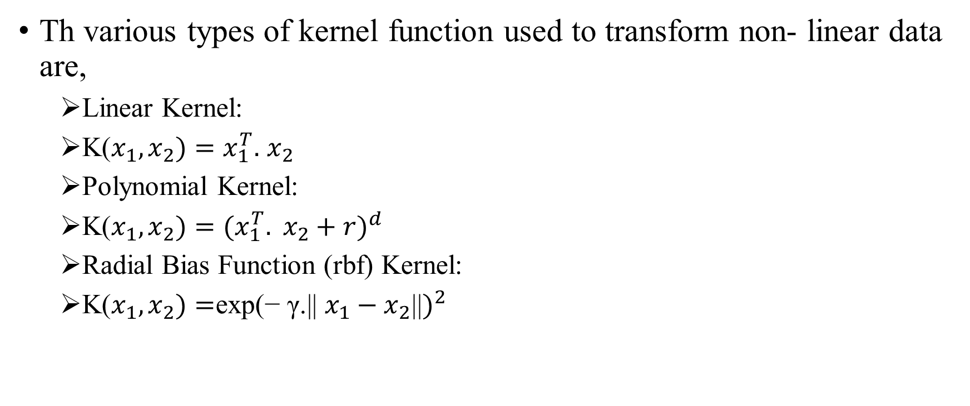
Types of SVM Kernels
Th various types of kernel function used to transform non- linear data are,
Linear Kernel:
K($x_{1},x_{2})=x_{1}^{T}.$ $x_{2}$
Polynomial Kernel:
K($x_{1},x_{2})={(x_{1}^{T}. x_{2}+r)}^{d}$
Radial Bias Function (rbf) Kernel:
K($x_{1},x_{2})=$exp${\text{(− }\text{γ}\text{.|| }x_{1}−x_{2}\text{||})}^{2}$

Slide 20
Advantages of SVM:
Effective in high-dimensional cases.
Its memory is efficient as it uses a subset of training points in the decision function called support vectors.
SVM are robust to overfitting as it uses a large margin or soft margin approach. This makes them suitable for scenarios where the data is noisy, or the number of features is high.
Different kernel functions can be specified for the decision functions and its possible to specify custom kernels.

Slide 21
Disadvantages of SVM:
Complexity in Parameter Tuning
Slower Training Time for Large Datasets
SVM is inherently a binary classifier, and extensions to multi-class problems may require techniques like one-vs-all (OvA) or one-vs-one (OvO), which can be computationally expensive.

Slide 22
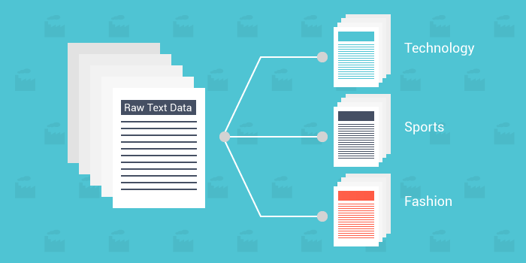
Applications:
• Text Classification
• Cancer Diagnosis
• Object Detection
[4]

Slide 23
Code for Example
Support Vector Machine Example-1
Support Vector Machine Example-2

Slide 24
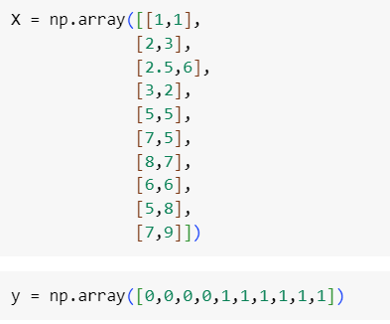
Code Explanation Example 1
The aim of the program is to understand how the Support Vector machine works using a simple 2D hard coded data set.
Import the necessary packages.
Using numpy array, a data set is created and named as X
An array of 0’s and 1’s is created and named as Y. This is the Binary labels. 0 and 1 are two labels indicating 2 classes.

Slide 25
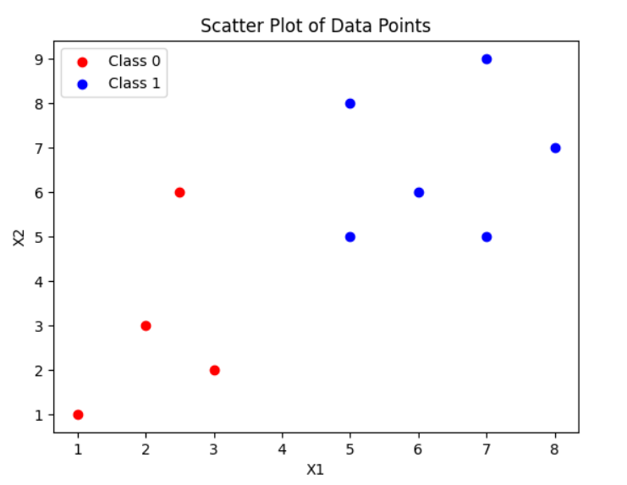
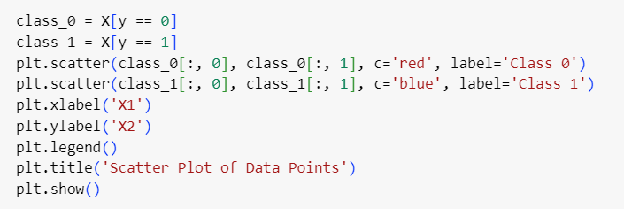
Code Explanation Example 1
Map the y labels with the data set created in X.
Scatter plot of data points mapped to the labels is created.

Slide 26
Code Explanation Example 1
SVM model is built for the above dataset using SVC function
Train the SVM model with the X and y values.
With the help of scatter plot and DecisionBoundayDisplay function, we can visualise the working of SVM model.
To check the model, take any data point from the plot and using if condition check which label the data point belongs to.

Slide 27
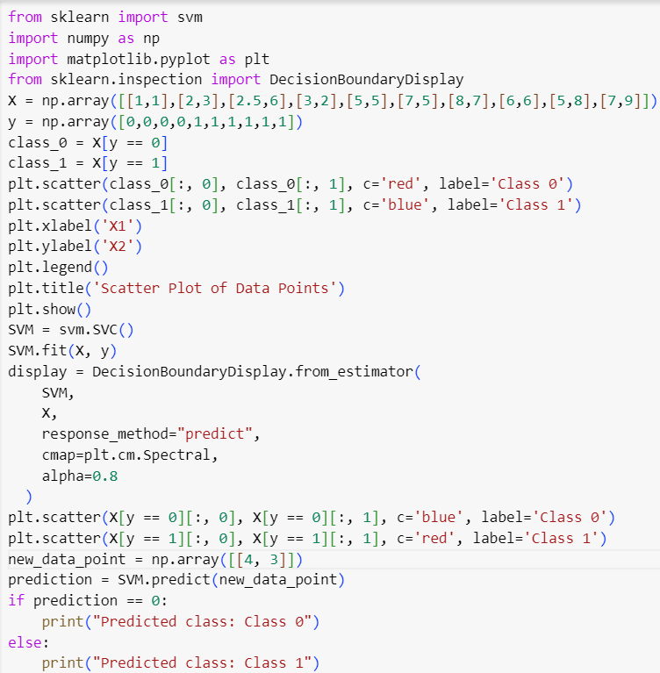
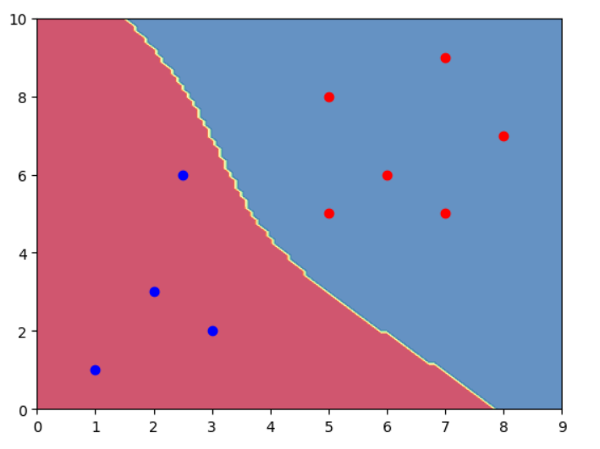
Code and Output Example 1

Slide 28
Code Explanation Example 2
The aim of the program is to use the existing breast cancer data set and an SVM model to predict whether a cancer's stage is malignant or benign.
Import necessary packages and load the breast cancer dataset.
Prediction is done using the dataset's mean radius and mean texture data. This is taken as X.
Target is taken as y variable as it contains binary values 0 and 1. 0 for malignant and 1 for benign.

Slide 29
Code Explanation Example 2
SVM model is built for the above dataset using SVC function. Here we are using kernel as linear. Alternatively, we can use any type of kernel.
Train the model with the X and y values.
With the help of predict method, the stage of the cancer is predict based on the trained values.
The accuracy of the model is then calculated with accuracy_score.
The model is visualised with the help of an inbuilt DecisionBoundaryDisplay function and scatter plot.

Slide 30
Code Explanation Example 2
To perform regression, the values are split into training and test variables.
The training variables are trained in SVM model.
Prediction is done with the test data and accuracy score is calculated with test data and predicted data.
The result is visualised with the help of DecisionBoundaryDisplay and Scatter plot.

Slide 31
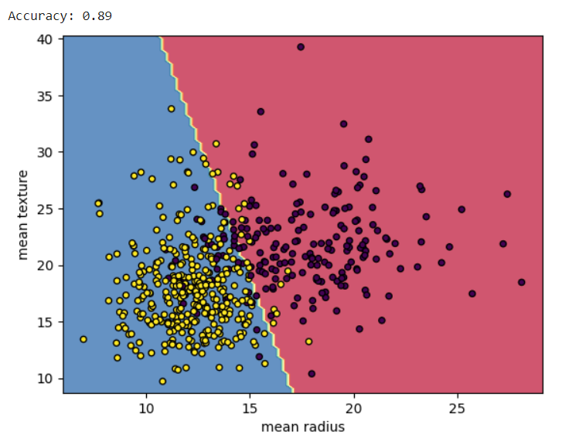
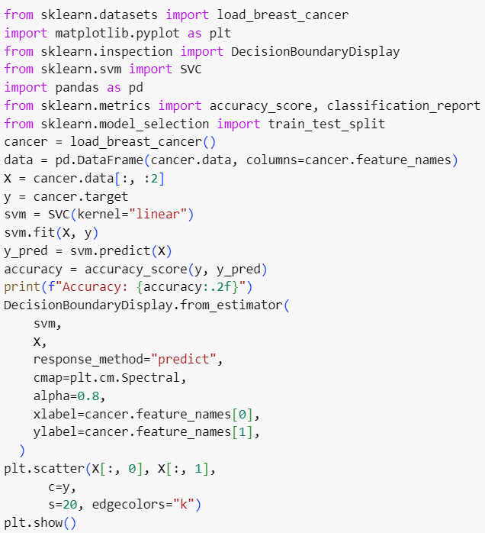
Code and Output Example 2

Slide 32
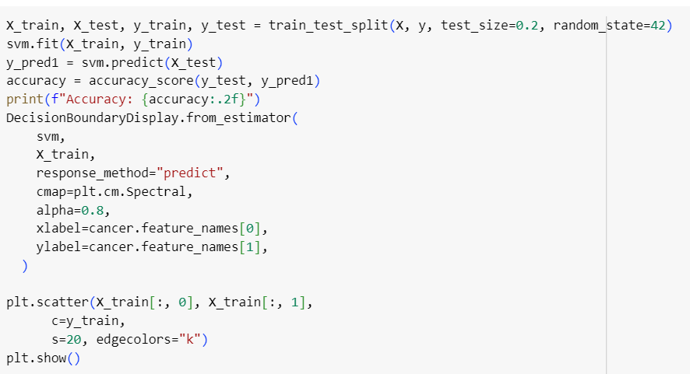
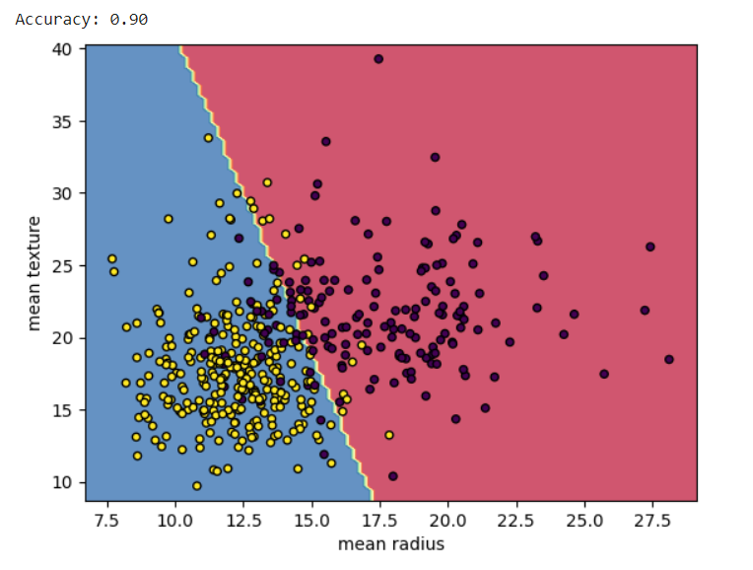
Code and Output Example 2

Slide 33
For Further Reference
Learning Support Vector Machines
[Source: https://www.youtube.com/watch?v=_PwhiWxHK8o&t=2551s]

Slide 34
Reference:
[1] “SSVM: a simple SVM algorithm,” ieeexplore.ieee.org. https://ieeexplore.ieee.org/abstract/document/1007516/ (accessed Oct. 20, 2023).
[2] V. Jakkula, “Tutorial on Support Vector Machine (SVM).” Available: https://course.ccs.neu.edu/cs5100f11/resources/jakkula.pdf
[3] aswathisasidharan, “Support Vector Machine Algorithm,” GeeksforGeeks, Jan. 20, 2021. https://www.geeksforgeeks.org/support-vector-machine-algorithm/
[4] G. Bedi, “Simple guide to Text Classification(NLP) using SVM and Naive Bayes with Python,” Medium, Nov. 09, 2018. https://medium.com/@bedigunjit/simple-guide-to-text-classification-nlp-using-svm-and-naive-bayes-with-python-421db3a72d34‌

